Slide 1
Bahdanau (Additive) Attention Mechanism
Neural Machine Translation using Attention

Slide 2
Assignment 1
Implement a Seq2Seq model with Bahdanau Attention and analyze attention weights without full training.
Dataset
Use a small English-French dataset. Example:
I am happy → Je suis heureux
# Toy dataset
input_texts = ['i am happy', 'i love you', 'he is good']
target_texts = ['je suis heureux', 'je t aime', 'il est bon']

Slide 3
Tokenization
tokenizer = tf.keras.preprocessing.text.Tokenizer(filters='')
tokenizer.fit_on_texts(input_texts + target_texts)
input_seq = tokenizer.texts_to_sequences(input_texts)
target_seq = tokenizer.texts_to_sequences(target_texts)
input_seq = tf.keras.preprocessing.sequence.pad_sequences(input_seq, padding='post')
target_seq = tf.keras.preprocessing.sequence.pad_sequences(target_seq, padding='post')

Slide 4
Encoder
def build_encoder(vocab_size, embedding_dim, enc_units):
encoder = tf.keras.Sequential([
tf.keras.layers.Embedding(vocab_size, embedding_dim),
tf.keras.layers.GRU(enc_units, return_sequences=True, return_state=True)
])
return encoder

Slide 5
Bahdanau Attention
class BahdanauAttention(tf.keras.layers.Layer):
def __init__(self, units):
super().__init__()
self.W1 = tf.keras.layers.Dense(units)
self.W2 = tf.keras.layers.Dense(units)
self.V = tf.keras.layers.Dense(1)
def call(self, query, values):
query = tf.expand_dims(query, 1)
score = self.V(tf.nn.tanh(self.W1(values) + self.W2(query)))
attention_weights = tf.nn.softmax(score, axis=1)
context_vector = attention_weights * values
context_vector = tf.reduce_sum(context_vector, axis=1)
return context_vector, attention_weights

Slide 6
Decoder
class Decoder(tf.keras.Model):
def __init__(self, vocab_size, embedding_dim, units):
super().__init__()
self.embedding = tf.keras.layers.Embedding(vocab_size, embedding_dim)
self.gru = tf.keras.layers.GRU(units, return_sequences=True, return_state=True)
self.fc = tf.keras.layers.Dense(vocab_size)
self.attention = BahdanauAttention(units)
def call(self, x, hidden, enc_output):
context_vector, attention_weights = self.attention(hidden, enc_output)
x = self.embedding(x)
x = tf.concat([tf.expand_dims(context_vector, 1), x], axis=-1)
output, state = self.gru(x)
output = self.fc(output)
return output, state, attention_weights

Slide 7
Forward Pass
vocab_size = len(tokenizer.word_index) + 1
embedding_dim = 64
units = 128
encoder = build_encoder(vocab_size, embedding_dim, units)
decoder = Decoder(vocab_size, embedding_dim, units)
sample_input = tf.convert_to_tensor(input_seq)
enc_output, enc_hidden = encoder(sample_input)
batch_size = input_seq.shape[0]
dec_input = tf.expand_dims(
[tokenizer.word_index['je']] * batch_size, 1
)
output, state, attn = decoder(dec_input, enc_hidden, enc_output)
print('Attention weights shape:', attn.shape)

Slide 8
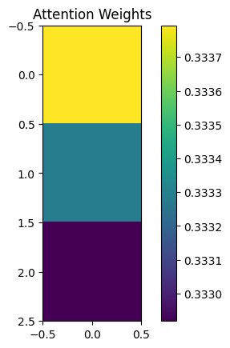
Visualize Attention
plt.imshow(attn[0].numpy(), cmap='viridis')
plt.colorbar()
plt.title('Attention Weights')
plt.show()

Slide 9
Assignment
Given the values and query, implement Bahdanau Attention and compute:
Attention scores
Attention weights
Context vector
Visualize attention
values = tf.constant([[[1.0, 2.0, 0.0],
[0.0, 1.0, 3.0],
[2.0, 0.0, 1.0]]])
query = tf.constant([[1.0, 1.0, 1.0]])

